Slide 1
Daily Review
Forms of Energy
Kinetic energy is movement energy.
Potential energy is stored energy.
Classify each of the following forms of energy as potential or kinetic
Heat, Elastic, Gravitational, Sound, Light, Nuclear, Electrical, Chemical

Slide 2
Daily Review
Forms of Kinetic Energy
Kinetic energy is movement energy.
Match each of the forms of kinetic energy to the type of movement it has.
1 Heat A Charges moving through a wire
2 Sound B Energy in vibrating objects
3 Light C Movement of particles within an object
4 Electrical D Photons moving in waves

Slide 3
Sound Production
Year 9 Physics

Slide 4

Learning Objectives
CFU
In your own words: what are we going to learn?
Identify sound as a form of longitudinal wave
Differentiate between areas of compression and rarefaction in a sound wave
Activate Prior Knowledge
The famous tagline to the 1979 thriller Alien is:
  “In space, no one can hear you scream”
Think pair share with your partner, do you think this is true? Why or why not?

Slide 5

Concept Development
CFU 1
True or false: The vibration of particles, results in the production of sound.
Sound
Sound energy is the vibration of particles or objects moving in a wavelike motion.
The guitar strings oscillate, causing particles in the air to compress together, and then move apart.
The resulting vibrations in the air particles reach our ear, and we interpret that as a sound.
CFU 2
How does a guitar string produce a sound wave?
Vocabulary
Oscillate: move back and forth in a regular rhythm

Slide 6
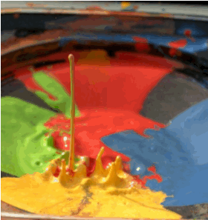

Concept Development
CFU 1
What type of wave is a sound wave?
Sound Waves
Sound wave are a type of longitudinal wave.
In a Longitudinal wave:
  The wave is produced by a source of vibration, called a sound source.
  The wave requires a medium to travel through, for example air, water or solid objects.
CFU 2
What do we call the point from which a sound is emitted?
Vocabulary
Sound Source: the point from which a sound wave is emitted. Medium: a substance through which a wave travels.

Slide 7
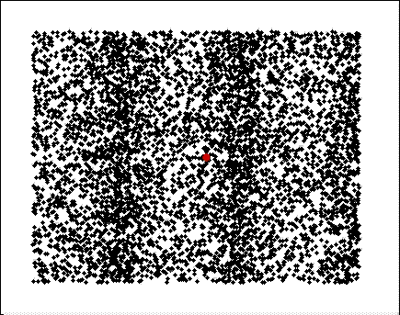
Concept Development
CFU 1
In which direction to particles move in a longitudinal wave?
Sound Waves
Sound wave are a type of longitudinal wave.
In a Longitudinal wave:
  Particles move parallel to the direction of wave movement.
  As each wave front passes, the particles return to their original position.
CFU 2
Think-pair-share: Describe the motion of the red particle in the image below.
Vocabulary
Parallel: extending in the same direction.

Slide 8
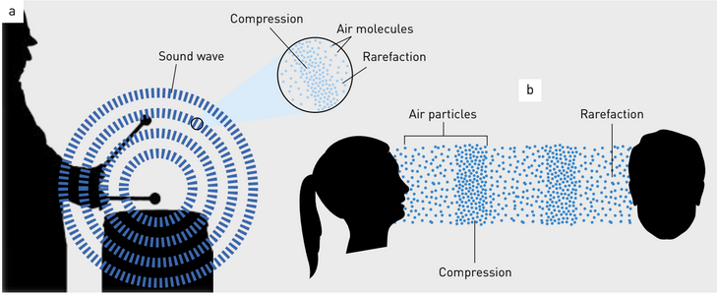
Concept Development
CFU 1
Using your own words, what is an area of compression in a sound wave?
Sound Waves
A sound wave is made up of 2 main areas:
  Compression: part of a sound wave where particles are forced close together.
  Rarefaction: part of a sound wave where particles are forced apart.
CFU 1
How is a compression different to a rarefaction?
CFU 2
Think-pair-share: Describe the motion of the red particle in the image below.
Vocabulary
Longitudinal wave: a wave where particles move in the direction of travel of the wave.

Slide 9


Skill Development / Guided Practice
CFU 1
What is the medium that the sound is travelling though?
Identify compression and rarefaction in a sound wave
Identify the medium through which the sound is travelling. Are the particles within a medium bunched together? compression Are the particles within the medium spread out? rarefaction
Jonny calls your name and the sound wave produced is shown below. Does the arrow show compression or rarefaction?
CFU 2
Are the particles bunched together or spread out?
The sound wave is travelling through air. The particles are bunched up, therefore the arrow shows an area of compression.
Reminders:
Medium: a substance through which a wave travels.

Slide 10

Skill Development / Guided Practice
CFU 1
What is the medium that the sound is travelling though?
Identify compression and rarefaction in a sound wave
Identify the medium through which the sound is travelling. Are the particles within a medium bunched together? compression Are the particles within the medium spread out? rarefaction
Mr Byrne is scuba diving and hears a boat start above him. Is the area of the sound wave show by the arrow a compression or rarefaction?
CFU 2
Are the particles bunched together or spread out?
The sound wave is travelling through _____. The particles _____, therefore the arrow shows an area of _______.
Reminders:
Medium: a substance through which a wave travels.

Slide 11
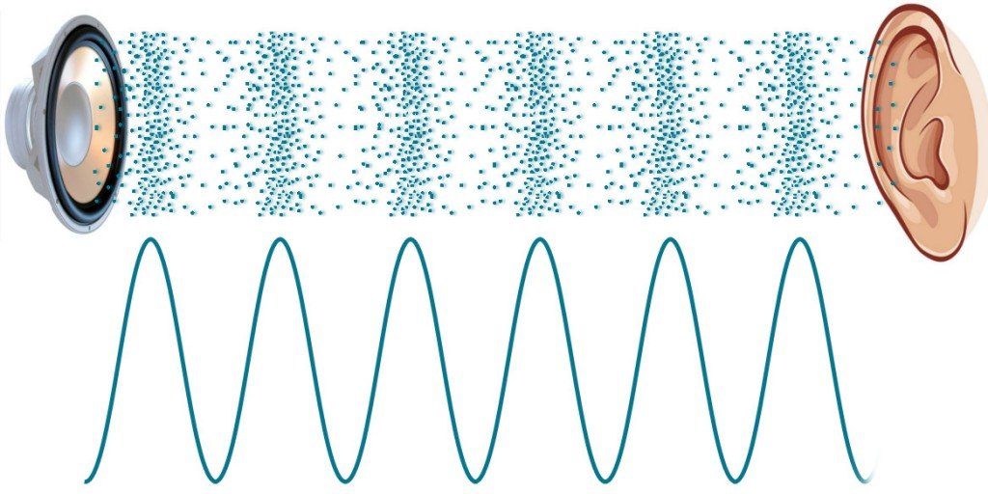
Skill Development / Guided Practice
CFU 1
What is the medium that the sound is travelling though?
Identify compression and rarefaction in a sound wave
Identify the medium through which the sound is travelling. Are the particles within a medium bunched together? compression Are the particles within the medium spread out? rarefaction
Mr Dudfield is at an Eminem concert and the sound wave coming from the speakers is shown below. Does the arrow show compression or rarefaction?
CFU 2
Are the particles bunched together or spread out?
The sound wave is travelling through _____. The particles _____, therefore the arrow shows an area of _______.
Reminders:
Medium: a substance through which a wave travels.

Slide 12

Skill Development / Guided Practice
CFU 1
What is the medium that the sound is travelling though?
Identify compression and rarefaction in a sound wave
Identify the medium through which the sound is travelling. Are the particles within a medium bunched together? compression Are the particles within the medium spread out? rarefaction
Mr Axtens is using a tuning fork to tune his guitar, the sound wave is shown below. Does the arrow show compression or rarefaction?
CFU 2
Are the particles bunched together or spread out?
Reminders:
Medium: a substance through which a wave travels.

Slide 13



Relevance
Understanding how a sound wave is produced will help you to explain a variety of sound related phenomena.
Longitudinal waves have a huge variety of uses such as:
  Fish finders and depth sounders
  Ultrasound to see into the human body
  Communication for some animals – echolocation used by dolphins and bats

Slide 14
Skill Closure
Create a neat drawing of a sound wave and label the following: compression, sound source, rarefaction, medium, direction of wave movement, direction of particle movement.
Skill Closure
In your own words, describe how a sound wave is produced, and how it travels from one location to another.
Skill Closure
“In space, no one can hear you scream”
Having completed the lesson, is this statement true or false? Explain your answer.

Slide 15
Independent Practice
Answer the following questions in your science book or on your device.
Explain how sound waves are formed.
Draw a neat diagram of a sound wave and label the following: compression, sound source, rarefaction, medium, direction of wave movement, direction of particle movement.
Define the following terms, in the context of sound:
    Longitudinal wave
    Compression
    Rarefaction
    Sound source
    Medium
    Oscillate
4. State two uses of sound waves in everyday life.

